Slide 1

Operating-System Services
Lecture #5

Slide 2
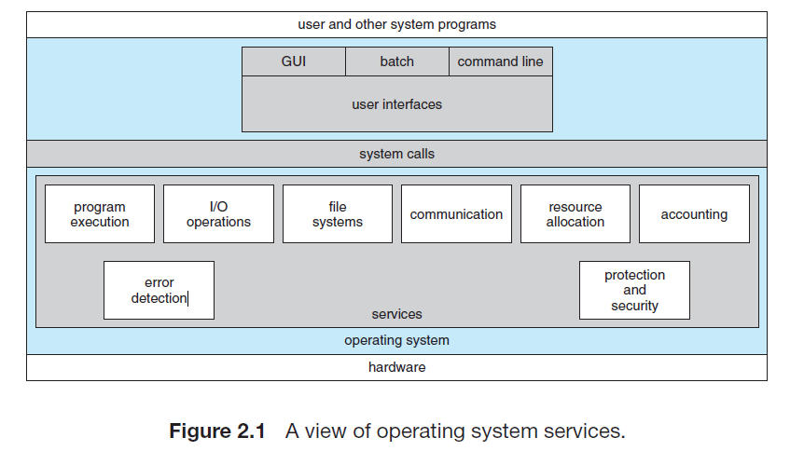
Operating System services

Slide 3
user interface (UI)
Most operating systems have a user interface (UI) that allows users to interact with the system. There are three main types:
Command-Line Interface (CLI): Users type text commands using a keyboard..
Graphical User Interface (GUI): Users interact with windows, menus, and icons using a mouse and keyboard.

Slide 4
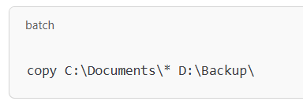
Batch Interface: Commands are written in files and executed automatically.
Example:
Imagine you need to back up files every day. Instead of copying them manually, you can create a batch file (backup.bat in Windows) with commands like:
When you run the file, it automatically copies all documents to the backup folder without needing further input.

Slide 5
Program execution.
The system must be able to load a program into memory and to run that program. The program must be able to end its execution, either normally or abnormally (indicating error).

Slide 6
I/O operations
A running program often needs to input or output (I/O) data, such as reading a file or using a device like a printer. Some devices need special actions, like burning a CD or turning off a screen.
For security and efficiency, users can’t control hardware directly. Instead, the operating system manages I/O operations.
Example:
When you print a document, your computer doesn’t send data straight to the printer. The OS handles the request, sends the data in the right format, and ensures the printer gets it correctly.

Slide 7
File-system manipulation
The file system helps programs manage files and folders. Programs can create, delete, read, and write files, search for specific files, and view file details.
Many operating systems also have permissions to control who can access or edit files, ensuring security. Different types of file systems exist, offering different features and performance.
Example:
On a Windows computer, you can create a folder, save a document inside it, rename it, or delete it. If the file is private, you can set permissions so only you can open it.

Slide 8
Communications
Sometimes, programs need to share information with each other. This can happen on the same computer or between different computers connected by a network.
There are two main ways programs can communicate:
Shared Memory: Two or more programs can read and write data in the same memory space.
Message Passing: Programs send and receive messages in a specific format through the operating system.

Slide 9
Example:
When you chat on WhatsApp, your message is sent from your phone to WhatsApp's server and then delivered to your friend's phone. This is an example of message passing between different devices over a network.

Slide 10
Error detection
The operating system constantly checks for errors to keep things running smoothly. Errors can happen in different areas, such as:
Hardware issues (like memory problems or a power failure)
I/O device issues (like a printer running out of paper or a network disconnect)
Program issues (like a math mistake or trying to use too much CPU power)
When the OS detects an error, it takes action to fix it, such as stopping the problem process or sending an error message for the program to handle. In some cases, the OS may need to shut down the system to avoid further issues.

Slide 11
Example:
If your printer runs out of paper while printing, the OS might show an error message asking you to reload paper. If a program tries to use too much memory, the OS might stop that program to prevent a crash.

Slide 12
Some operating system functions focus on making the system run efficiently, especially in multi-user systems. These functions help share resources like CPU and memory among users to improve overall performance.

Slide 13
Resource Allocation
When multiple users or jobs are running at the same time, the operating system makes sure each one gets the resources it needs. These resources can include things like CPU time, memory, and storage.
For example, the OS uses CPU scheduling to decide which jobs get time on the CPU, considering factors like speed and available memory. It also manages other devices, like printers or USB drives, making sure they are allocated when needed.

Slide 14
Example:
If you are running a word processor and a music player at the same time, the OS will make sure both programs get the CPU time they need without interfering with each other.

Slide 15
Accounting
Accounting in an operating system keeps track of how much and what kind of resources each user is using. This information can be used for things like billing or to collect usage statistics to improve the system.
Example:
In a shared computer system, the OS might track how much CPU time or storage each user uses. This way, if users are billed for usage, the OS can calculate how much each user owes. It can also help improve the system by showing which resources are most used.

Slide 16
Protection and security
Protection and security ensure that users and processes can't interfere with each other's data or the system itself.
Protection makes sure only authorized users can access certain system resources.
Security focuses on preventing outsiders from breaking into the system by requiring things like passwords for access and monitoring for suspicious activity.

Slide 17
Example:
When you log into your computer, you use a password to prove your identity. The operating system makes sure only you or other authorized users can access your files. If someone tries to hack into your system, the OS will block the attempt and may even record the event to help catch the intruder.

Slide 18
Question?

